Slide 1
ZERO TO 60:
ONE COLLEGE'S PATH TO REVAMPING INSTITUTION-WIDE ASSESSMENT
Aaron Roe and Shelley Barkley
Sauk Valley Community College

Slide 2
AGENDA
Introduction
Background
Goals and Objectives
Pedal to the Metal
New Assessment Process
Implementation
Benefits and Outcomes
Training and Support
Timeline
Q & A
Next Steps

Slide 3
INTRODUCTION
Our why: HLC
From that day on we were living life in the fast lane of assessment.

Slide 4
BACKGROUND
2021 Assessment Review from HLC
Special Focus Report on 4.C.
Program-level learning outcomes and targets for certificate and associate degree programs with and without program concentrations;
The assessment of program-level student learning outcomes, including data generated, data analysis, and improvement efforts based on data analysis, and the documented effect of improvement efforts;
The institution's definition of co-curricular areas. A formalized outcomes assessment process for co-curricular areas, data from the assessment of identified co-curricular outcomes, data analysis, and the documented effect of improvement efforts; and
Data from the assessment of general education competencies, data analysis, and the documented effect of improvement efforts
Where we were in Assessment:
Had Institutional, Area, Discipline, and Course outcomes…
Had a reporting mechanism within an Internal Sharepoint page called “FAST”.
We had begun discussion on what co-curricular outcomes would mean for us…
But it all felt like just busy work to all faculty and staff… there was no meaning behind assessment at SVCC.

Slide 5
SO WE DID THIS…

Slide 6
GOALS AND OBJECTIVES
Make our assessment process meaningful
Get rid of old reporting database (FAST)
Establish a new set of competencies
Create ties through mapping of importance to those new competencies
Talk to faculty to get college-wide feedback
Revisit with new feedback and make corrections
Migrate to using Canvas as new database
Present college-wide at the Fall 2023 college-wide Kickoff
Run a report from Canvas and put Tableau
Ultimately meet and exceed HLC’s interim monitoring report in 2026…

Slide 7
PEDAL TO THE METAL
Joined Assessment Academy
Building a Team
Timeline (Quick response)
Administrative support to dedicate resources to the process
Money
Additional Faculty Contracts
Time

Slide 8
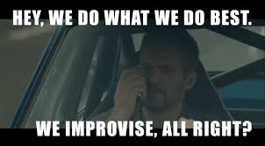
NEW ASSESSMENT PROCESS
Align competencies to program review needs and IAI requirements
New GECC Outcomes
Spent time distinguishing between course level, area level, and program level outcomes
Created a map for identifying reporting levels
Created a flowchart that outline discipline level, operational level, and strategic level planning
Academic, Co-Curriculum, Institutional level outcomes

Slide 9
Communications | Humanities and Fine Arts | Physical and Life Sciences | Social and Behavioral Sciences | Mathematics
COM1. Compose a message that addresses the audience’s needs. | HFA1. Apply methods of critical analysis to explore the elements of a work. | P/LS1. Generate and refine scientific knowledge through evidence-based decisions. | SBS1. Identify global and cross-cultural perspectives on social issues. | MAT1. Interpret or apply mathematical reasoning in the appropriate context.
COM2. Incorporate appropriate outside evidence. | HFA2. Interpret the elements of a work to identify meaning. | P/LS2. Explain the importance of science to society (IAI 25%) | SBS2. Understand and apply principles that govern behavior to enhance or explain interactions between individuals and groups. | MAT2. Perform mathematical formulas.
COM3. Accurately use discipline-appropriate citation style to document sources. | HFA3. Analyze recurring human principles and problems in their social, political, religious, and cultural contexts. | P/LS3. Use scientific process skills within a laboratory setting (observing, inferring, measuring communication, classifying, predicting) to explain or predict an outcome. |  | MAT3 Analyze or interpret the results of mathematical computations.
COM4. Analyze a variety of texts to identify purpose and meaning.

Slide 10
MAPPING TO COURSES
Courses: COM ENG 101, 103 SPE 131 | Courses: HUM LAN 262 ENG 160, 201, 203, 212, 225, 226, 227, 228, 230 EDU 221 PHL 101, 102, 103, 104 FA MUS 201 THE 141 ART 118, 119, 120, 121, 122 HUM 112 INTERDISCIPLINE HUM 150, 210 | Courses: LS BIO 103, 104, 105, 123, 131, 140 PS CHE 102, 103, 105 GSC 105, 106, 115 PHY 175, 201, 211 | Courses SBS SOC 111, 112, 115, 116, 251 ECO 211, 212 HIS 131, 132, 155, 221, 222 GEO 122 PSC 163, 164, 232, 233, 251, 261 PSY 103, 200, 214, 215 | Courses MAT MAT 111, 115, 203, 204, 205, 220, 221, 230, 240

Slide 11
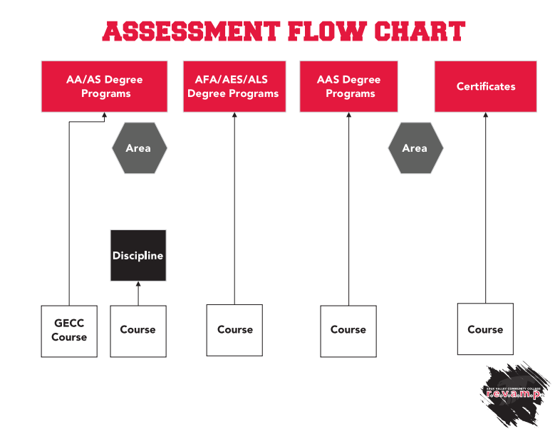
GECC V. PROGRAM LEVEL OUTCOMES

Slide 12
CO-CURRICULAR OUTCOMES
Mission:
Sauk Valley Community College is dedicated to teaching and scholarship while engaging the community in lifelong learning, public service, and economic development.
Shared Ethical Values:
Sauk Valley Community College respects the worth and dignity of all people; stands for integrity and fairness; and encourages responsibility, accountability, and persistence in a caring, supportive environment.
Leadership and Collaboration
Civic Engagement
Diversity and Equity

Slide 13
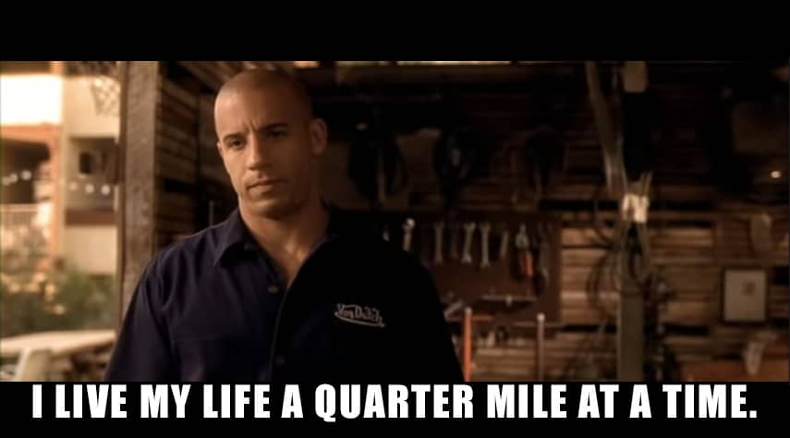
IMPLEMENTATION PLAN
Roll out the new Assessment process
Align all new competencies within Canvas
Implement a system with ongoing monitoring and evaluation
Collect data on effectiveness of the new process
Gather feedback from faculty and staff
Celebrate any successes along the way

Slide 14
BENEFITS AND OUTCOMES
A set of competencies that can be used for a wide array of needs.
Provide meaningful results showing levels of mastery on the IAI requirements that are already tied to our associate degree programs.
Clean up already established program level outcomes and provide enhanced reporting in Canvas
Use assessment in a way that is truly meaningful for insights into student learning at Sauk Valley Community College.

Slide 15
TRAINING AND SUPPORT
Instructional Design: Training on Canvas usage and outcomes
Rubrics and Outcomes
New Quizzes v. Old
Assigning levels of mastery
Deans and Institutional Research:
Faculty Leader Alignment and Committee Restructuring
Mapping to levels of courses, programs, and GECC competencies

Slide 16
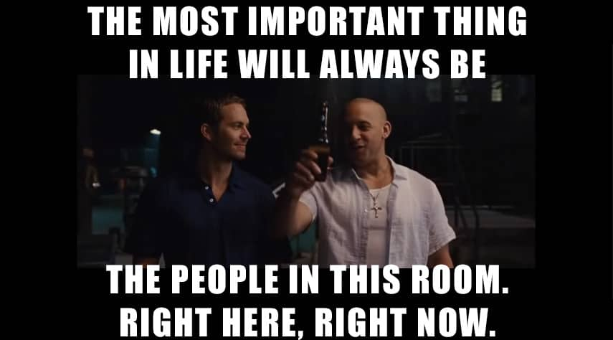
NEXT STEPS
Expanded Co-Curricular Reporting
Cross-Curricular Outcomes for the College
Tableau Dashboards

Slide 17
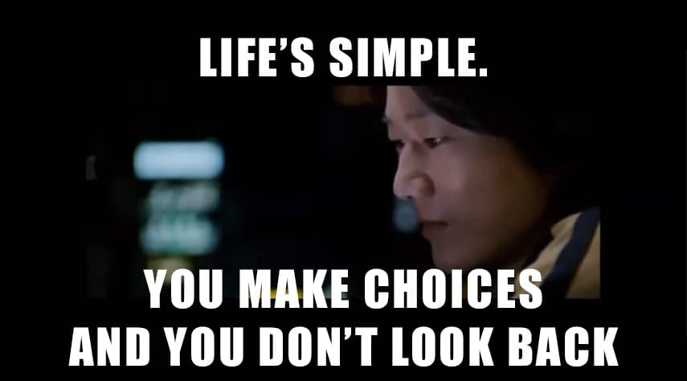
LESSONS LEARNED…
You can never, ever, ever communicate anything enough or without graphs
Levity can go a long way with difficult discussions
There is a light at the end of the tunnel, even though the work of continuous improvement on assessment never ends
It’s worth it

Slide 18
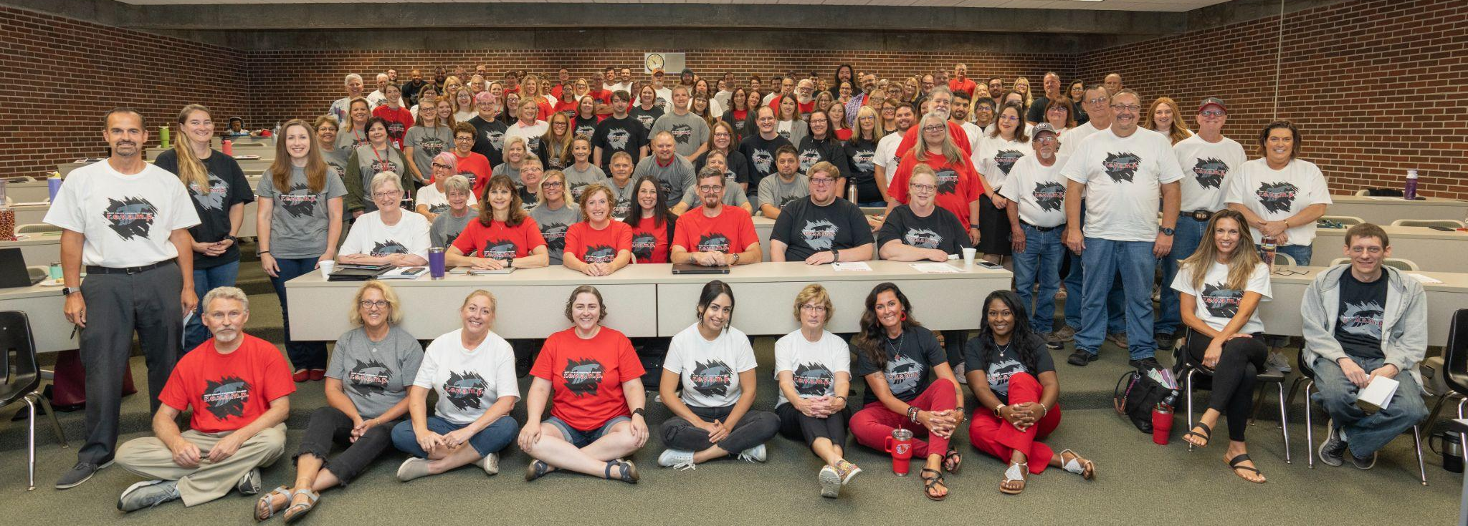
Q&A

